Slide 1
Chemical Equations
Chapter 8
Outline
Chemical Reactions
Evidence
Balancing
Types of Reactions
Combination/Synthesis
Combustion
Decomposition
Single Replacement
Double Replacement

Slide 2
2 C₈H_{16 (l)} + 25 O_{2 (g)} → 16 CO_{2 (g)} + 18 H₂O _{(l)} + heat
What happens to the octane molecule when it undergoes combustion?

Slide 3
Evidence for Chemical Reactions
A gas is produced.
A precipitate is formed.
A permanent color change is observed.
An energy change occurs.

Slide 4
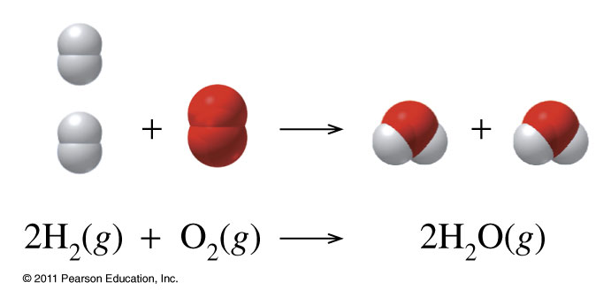
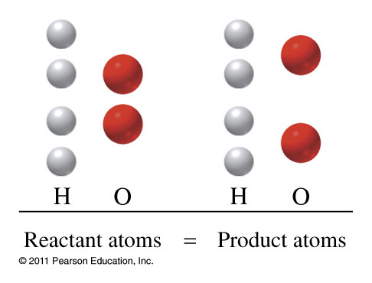
Chemical Equations
Must be balanced to satisfy Law of conservation of mass
State Designations
(g) gas
(l) liquid
(s) solid
(aq) aqueous

Slide 5
What information is shown in a balanced chemical equation?
Zn _{(s)} | + | 2 HCl _{(aq)} | → | ZnCl_{2 (aq)} | + | H_{2 (g)}
1 molecule |  | 2 molecules |  | 1 formula unit |  | 1 molecule
1 atom Zn |  | 2 atoms H 2 atoms Cl |  | 1 atom Zn 2 atoms Cl |  | 2 atoms H
1 mole |  | 2 moles |  | 1 mole |  | 1 mole
65.38 g |  | 2(36.46 g) |  | 136.28 g |  | 2.02 g
138.30 g |  |  | = | 138.30 g

Slide 6
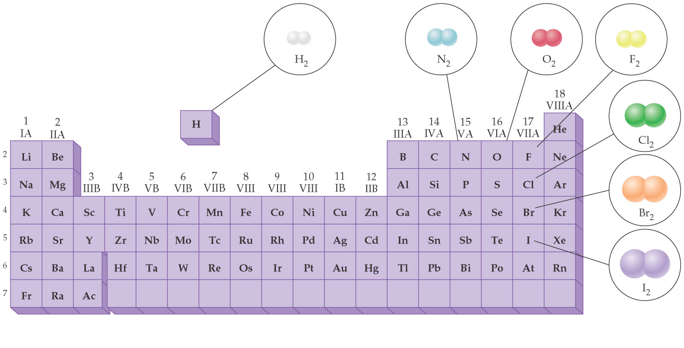
Diatomic Elements

Slide 7
Classifying Reactions by what Atoms Do

Slide 8
Classifying Reactions by what Atoms Do
Combination/Synthesis
A + Z ⎯→ AZ

Slide 9
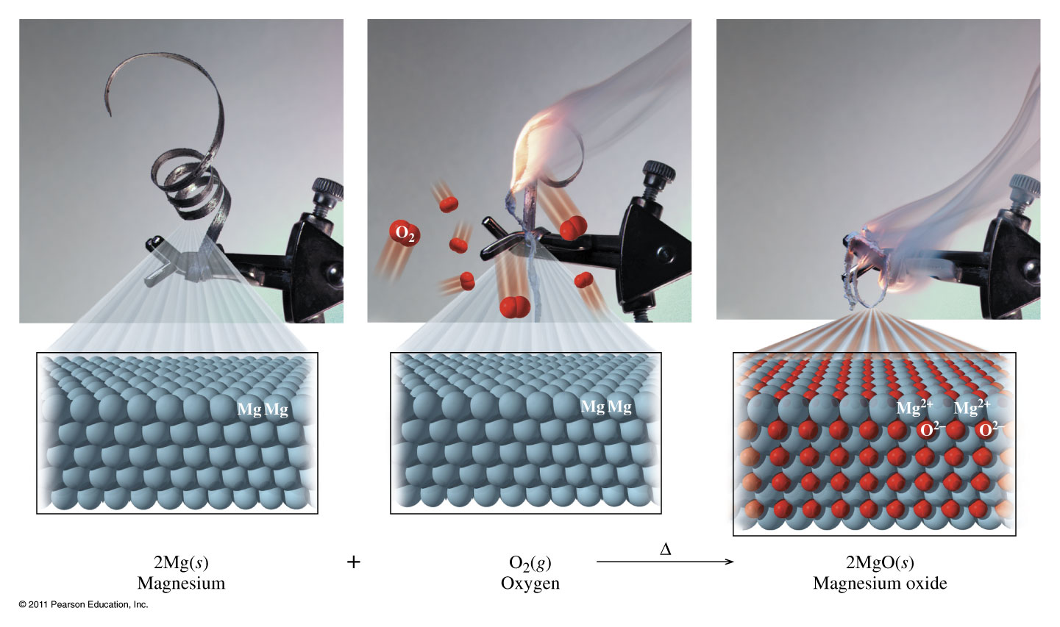
Combination Reaction

Slide 10
Example – Combination Reactions
Solid magnesium oxide combines with carbon dioxide gas to produce solid magnesium carbonate.
What is the sum of the coefficients?

Slide 11
Example – Combination Reactions
Lead filings are heated with phosphorus powder, P, to yield lead(IV) phosphide solid.
What is the coefficient of the lead?

Slide 12
Example – Combination Reactions
Chromium metal is heated with nitrogen gas to give chromium(III) nitride solid.
What is the coefficient of the product?

Slide 13
Example – Combination Reactions Combustion Reactions
Lithium metal is heated in the presence of oxygen gas.
What is the formula of the product?
LiO
Li₂O
Li
O₂
LiO₂

Slide 14
Example – Combination Reactions Combustion Reactions
Copper metal is heated with oxygen gas to produce copper(I) oxide.
What is the sum of the coefficients of the reactants?

Slide 15
Example – Combination Reactions Combustion Reactions
Chlorine gas is heated with oxygen gas to produce dichlorine trioxide gas.
What is the coefficient of the product?

Slide 16
Example – Combination Reactions Combustion Reactions
Propane gas, C₃H₈, is used in gas barbecues. Write the balanced combustion reaction.
C₃H_{8 (g)} + O_{2 (g)} → 3 CO _{(g)} + 4 H₂ _{(g)}
B. C₃H_{8 (g)} + O_{2 (g)} → CO_{2 (g)} + H₂O _{(g)}
C. 2 C₃H_{8 (g)} + 10 O_{2 (g)} → 6 CO_{2 (g)} + 8 H₂O _{(g)}
D. C₃H_{8 (g)} + 5 O_{2 (g)} → 3 CO_{2 (g)} + 4 H₂O _{(g)}
E. C₃H_{8 (g)} + O_{2 (g)} → no reaction

Slide 17
Example – Combination Reactions Combustion Reactions
The liquid ethanol, CH₃CH₂OH, is often used to warm desserts by flambéing.
How many moles of ethanol are needed to balance the chemical reaction?

Slide 18
Classifying Reactions by what Atoms Do
Decomposition
AZ ⎯→ A + Z

Slide 19
Decomposition

Slide 20
Example – Redox Reactions Decomposition Reactions
Hydrogen peroxide is used to clean wounds. It is stored in brown bottles to prevent it’s decomposition into water and oxygen gas.
What is the coefficient of the hydrogen peroxide?

Slide 21
Example – Redox Reactions Decomposition Reactions
Silver bicarbonate decomposes by heating to silver carbonate powder, water, and carbon dioxide gas.
What is the sum of the coefficients?

Slide 22
Example – Redox Reactions Decomposition Reactions
Silver carbonate further decomposes upon heating to silver oxide and carbon dioxide.
What is the sum of the coefficients now?

Slide 23
Example – Redox Reactions Decomposition Reactions
Stannous chlorate decomposes upon heating to yield stannous chloride and oxygen gas.
What is the balanced chemical equation?
Sn(ClO₃)_{2 (s)} → SnCl_{2 (s)} + 3 O_{2 (g)}
Sn(ClO₂)_{2 (s)} → SnCl_{2 (s)} + 4 O_{2 (g)}
Sn(ClO₂)_{2 (s)} → no rxn
SnCl_{2 (s)} + 3 O_{2 (g)} → Sn(ClO₃)_{2 (s)}

Slide 24
Copper(II) oxide reacts with ammonia (NH₃) to yield copper, nitrogen gas, and water.
Write a balanced equation for this reaction.

Slide 25
Lead(II) nitrate reacts with potassium chromate to form lead(II) chromate (yellow ppt.) and potassium nitrate.
Hydrochloric acid reacts with sodium carbonate to form carbon dioxide, sodium chloride, and water

Slide 26
Zinc metal reacts with hydrochloric acid to produce zinc chloride and hydrogen gas.
Potassium chlorate when heated, decomposes to form potassium chloride and oxygen gas.

Slide 27
Hexane(C₆H₁₄) burns in oxygen gas to form carbon dioxide and water.
Vinegar(acetic acid) reacts with baking soda (sodium bicarbonate) to produce carbon dioxide gas, sodium acetate, and water.
Ammonia reacts with oxygen gas to form nitrogen monoxide and water.

Slide 28
Iron(III) chloride reacts with ammonium hydroxide to form iron(III) hydroxide (brown ppt.) and ammonium chloride.
Barium hydroxide and ammonium chloride react to form ammonia (NH₃), water, and barium chloride.

Slide 29
Some more examples
N₂ + H₂ ⎯→ NH₃
Be₂C + H₂O ⎯→ Be(OH)₂ + CH₄
HCl + CaCO₃ ⎯→ CaCl₂ + H₂O + CO₂
C₂H₆ + O₂ ⎯→ CO₂ + H₂O

Slide 30
Classifying Reactions by what Atoms Do
Single Displacement
A + BZ ⎯→ AZ + B

Slide 31
Single Replacement

Slide 33
Example – Redox Reactions Single Replacement Reactions
Activity
Series of
Metals
Li
K
Ba
Sr
Ca
Na
Mg
Al
Mn
Zn
Cr
Fe
Cd
Co
Ni
Sn
Pb
(H)
Sb
Cu
Ag
Pd
Pt
Hg
Au
Aluminum wire is placed in a cupric nitrate solution. What is the sum of the coefficients?

Slide 34
Example – Redox Reactions Single Replacement Reactions
Activity
Series of
Metals
Li
K
Ba
Sr
Ca
Na
Mg
Al
Mn
Zn
Cr
Fe
Cd
Co
Ni
Sn
Pb
(H)
Sb
Cu
Ag
Pd
Pt
Hg
Au
Copper wire is placed in a solution of magnesium nitrate. What is the balanced chemical equation?
Cu _{(s)} + Mg(NO₃)_{2 (aq)} → Mg _{(s)} + Cu(NO₃)_{2 (aq)}
Cu _{(s)} + Mg(NO₃)_{2 (aq)} → MgCu _{(s)} + NO_{2 (g)}
Cu _{(s)} + Mg(NO₃)_{2 (aq)} → MgCu _{(s)} + 2 NO₃ ⁻_{(aq)}
Cu²⁺ _{(s)} + Mg(NO₃)_{2 (aq)} → Mg²⁺ _{(aq)} + Cu(NO₃)_{2 (aq)}
No reaction

Slide 35
Example – Redox Reactions Single Replacement Reactions
Activity
Series of
Metals
Li
K
Ba
Sr
Ca
Na
Mg
Al
Mn
Zn
Cr
Fe
Cd
Co
Ni
Sn
Pb
(H)
Sb
Cu
Ag
Pd
Pt
Hg
Au
Magnesium ribbon is placed in a hydrochloric acid solution. What is the coefficient in front of the magnesium?

Slide 36
Example – Redox Reactions Single Replacement Reactions
Activity
Series of
Metals
Li
K
Ba
Sr
Ca
Na
Mg
Al
Mn
Zn
Cr
Fe
Cd
Co
Ni
Sn
Pb
(H)
Sb
Cu
Ag
Pd
Pt
Hg
Au
A piece of soft, gray lithium metal is added to water.
What is the coefficient of lithium?

Slide 37
Example – Redox Reactions Single Replacement Reactions
Activity
Series of
Metals
Li
K
Ba
Sr
Ca
Na
Mg
Al
Mn
Zn
Cr
Fe
Cd
Co
Ni
Sn
Pb
(H)
Sb
Cu
Ag
Pd
Pt
Hg
Au
Manganese chips are added to nitric acid. What gas is formed?

Slide 38
Cu + AgNO₃→

Slide 39
Cr + NiCl₂ →

Slide 40
Cr + Zn(NO₃)₂ →

Slide 41
Zn + HCl →

Slide 42
Fe + HCl →

Slide 43
Classifying Reactions by what Atoms Do
Double displacement
AX + BZ ⎯→ AZ + BX
Precipitation (solubility rules)
Gas formation (H₂S, CO₂, NH₃, SO₂)
Slightly ionizable substance (weak acid/weak base)
Neutralization (special type of double displacement reaction)
HX _{(aq)} +BOH _{(aq)} ⎯→ BX +H₂O _{(l)}

Slide 44
Double Displacement

Slide 45
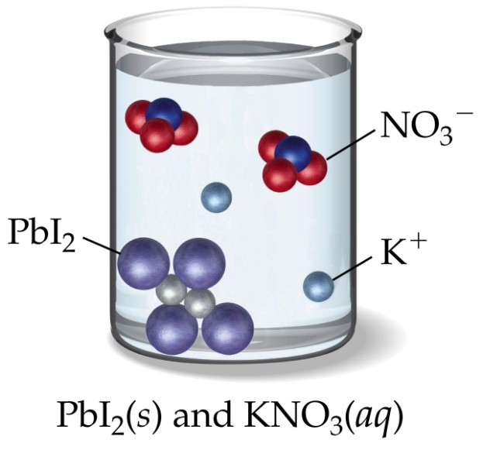
Predicting Reactions Double Displacement

Slide 46
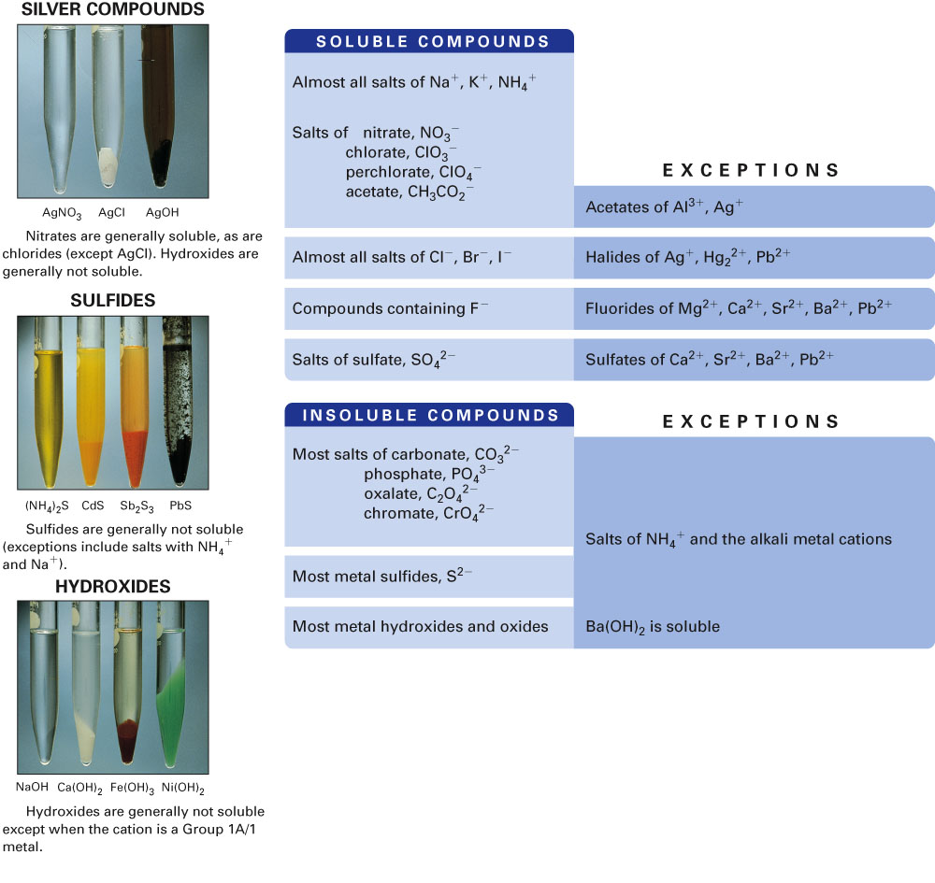
Fig. 9-13, p. 256

Slide 47
Common Strong Acids and Bases
Common Strong Bases
Lithium hydroxide LiOH _{(aq)}
Sodium hydroxide NaOH _{(aq)}
Potassium hydroxide KOH _{(aq)}
Strontium hydroxide Sr(OH)₂ _{(aq)}
Barium hydroxide Ba(OH)₂ _{(aq)}
Calcium hydroxide Ca(OH)_{2 (aq)}
Common Strong Acids
Hydrochloric acid HCl _{(aq)}
Hydrobromic acid HBr _{(aq)}
Hydroiodic acid HI _{(aq)}
Perchloric acid HClO_{4 (aq)}
Chloric acid HClO_{3 (aq)}
Nitric acid HNO_{3 (aq)}
Sulfuric acid H₂SO_{4 (aq)}

Slide 48
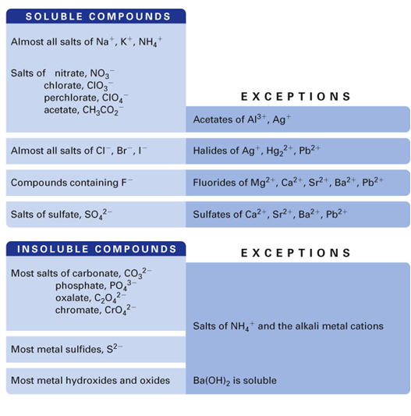
Example – Ion Exchange Reactions
What is the precipitate when lead(II) nitrate reacts with lithium chloride?

Slide 49
Example – Ion Exchange Reactions
What gas is formed when sodium sulfite reacts with hydrobromic acid?
H₂SO_{3 (g)}
H₂S _{(g)}
SO_{3 (g)}
SO_{2 (g)}

Slide 50
Example – Ion Exchange Reactions
When aqueous solutions of sodium sulfite and potassium bromide are mixed the products are:
NaBr and K₂SO₃
K₂SO₃ and Na₂Br
NaK and SO₃Br
No reaction

Slide 51
Example – Ion Exchange Reactions
Aqueous sodium acetate is mixed with hydrobromic acid. What is formed?
Precipitate
Gas
Slightly ionizable substance
No reaction

Slide 52
Example – Ion Exchange Reactions
When aqueous solutions of sodium iodide and nitric acid are mixed the products are:
NaI and HNO₃
NaNO₃ and NaI
NaH and INO₃
No reaction

Slide 53
Example – Ion Exchange Reactions
When sulfuric acid and aqueous lithium hydroxide are mixed one of the products is
Water
Lithium hydride
Sulfur trioxide
Lithium sulfide
No reaction

Slide 54
Na₂S + ZnCl₂ →
Na₂S + ZnCl₂ →2 NaCl + ZnS(s)

Slide 55
Mg(NO₃)₂ + NaOH →
Mg(NO₃)₂ + 2 NaOH → Mg(OH)₂(s)+ 2 NaNO₃

Slide 56
AgNO₃ + Na₂SO₄→
AgNO₃ + Na₂SO₄→ NR

Slide 57
K₂CO₃ + HCl →
K₂CO₃ + 2 HCl → (H₂CO₃ + 2 KCl)
→H₂O + CO₂ + 2 KCl

Slide 58
NH₄Cl + KOH →
NH₄Cl + KOH → (NH₄OH + KCl) →
NH₃ +HOH+ KCl

Slide 59
HNO₃ + NaC₂H₃O₂ →
HNO₃(aq) + NaC₂H₃O₂(aq)
→ HC₂H₃O₂(aq) + NaNO₃(aq)

Slide 60
HClO₄ + NaOH →
HClO₄ + NaOH → H₂O(l) + NaClO₄

